Slide 1
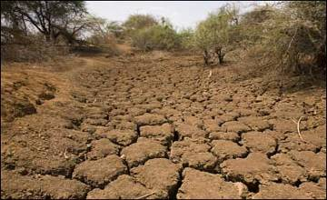
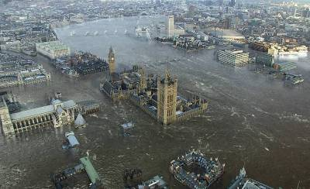
Natural disasters

Slide 2
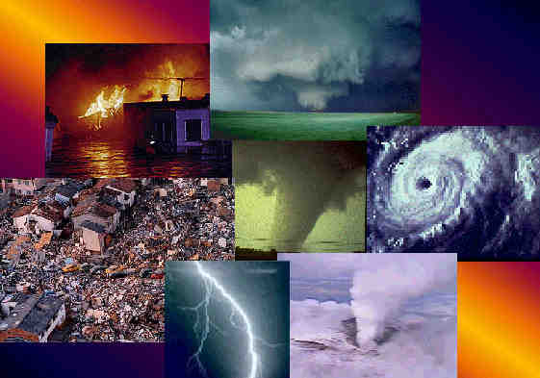
Every year different natural disasters happen in our planet.
Earthquake
Hurricane
Tornado
Volcano
Flood
Drought

Slide 3
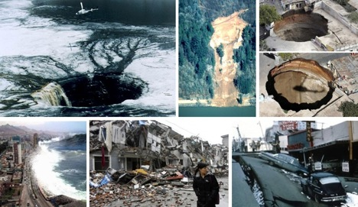
They destroy cities and towns, injure people and animals.

Slide 4
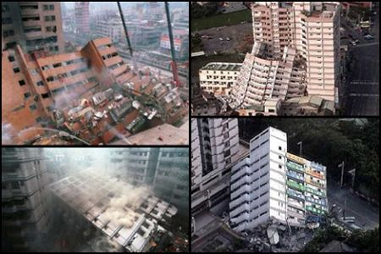
An earthquake is a sudden shaking of the ground. It usually happens in Japan, China, India, the USA, Armenia, Portugal.

Slide 5
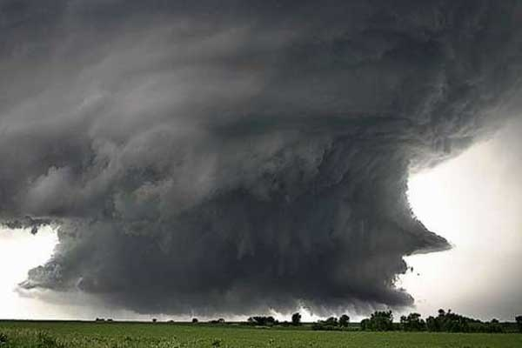
A hurricane is a very violent wind or storm. It usually happens in Japan, China, the Philippines.

Slide 6
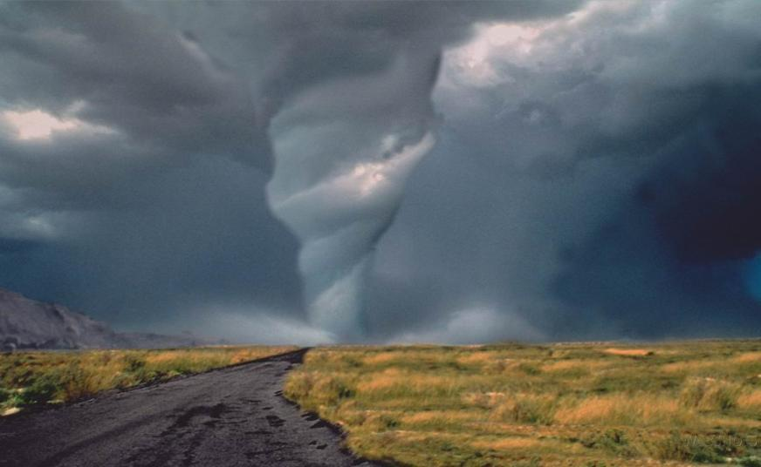
A tornado is a very violent wind in the form of a funnel of air that spins at great speed. It usually happens in the USA.

Slide 7
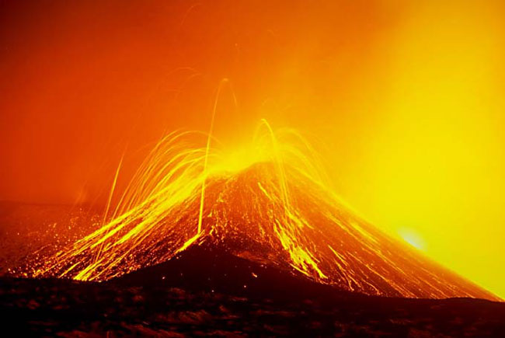
A volcano is a mountain with a hole called a crater in the top. Sometimes lava and gases are thrown from the crater. It usually happens in Italy, Salvador, Hawaii, the Russian Federation.

